Slide 1
Introduction to Chemistry
2.1 (Concept 1)

Slide 2
What is wrong with this picture?

Slide 3
Discuss
What is a chemical? Give examples.
Are chemicals bad for us?
Why/where/how might this misconception that chemicals are bad for us have arisen?
If something is natural or organic, does that mean it is good for you or healthier?

Slide 4
Appeal to Nature (not testable)
An appeal to nature is an argument that claims that something is either good because it is considered ‘natural’, or bad because it is considered ‘unnatural’. (effectiviology)
E.g. Herbal medicine is natural, so it is good for you.
E.g. Antibiotics are unnatural, so they are bad for you.
More reading: https://effectiviology.com/appeal-to-nature-fallacy/

Slide 5
Textbook Stuff
Read page 96 and take notes on the definitions of “chemical” and “matter” (and anything else interesting)
Question in Figure 2.1 caption (point form ok).
“Before you leave this page” questions 1 and 2.

Slide 6
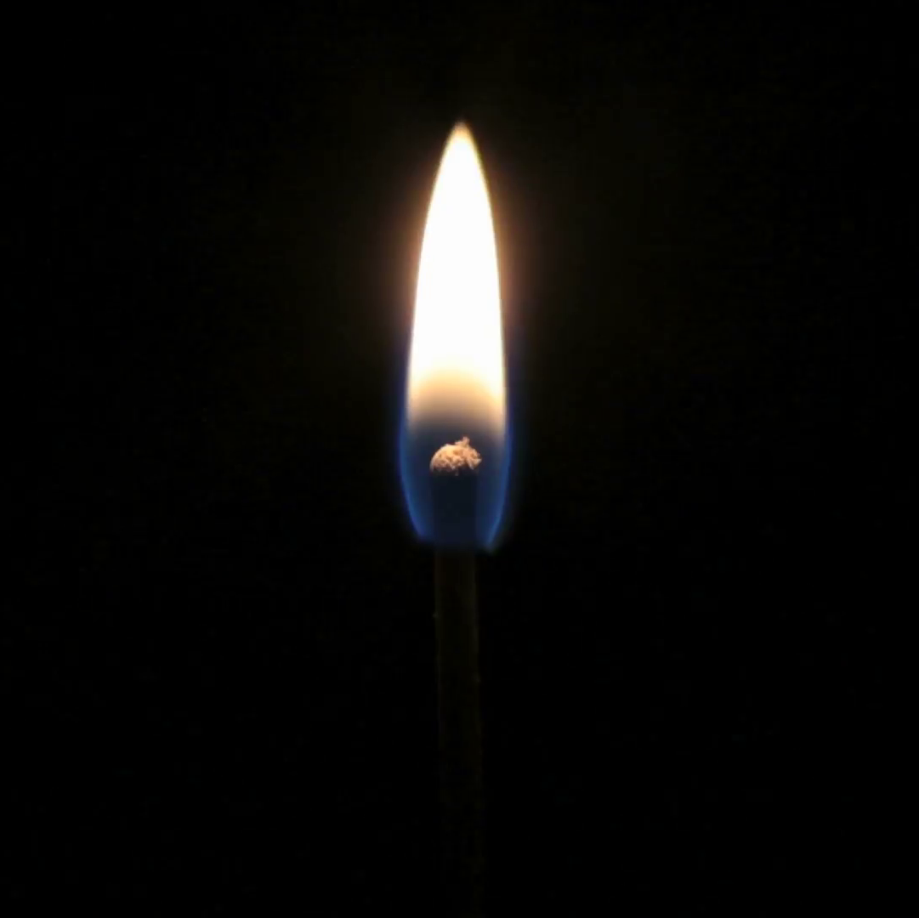
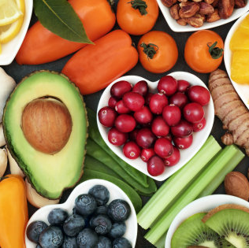
The Heart of the Matter
Share and critique your alternate definition of ‘matter’ with a partner.
Which of the following pictures are considered matter? Which are not?

Slide 7
Matter vs Chemical
Matter:
“anything that has mass and takes up space” (textbook)
“any pure substance (an element) or any mixture (a solution, compound, or gas)” (thoughtco)
Chemical:
“certain substances or mixtures of substances…no specific scientific meaning…everything in the world that isn’t energy is a chemical or contains chemicals”
“any substance consisting of matter…occur naturally and can be made artificially” (thoughtco)

Slide 8
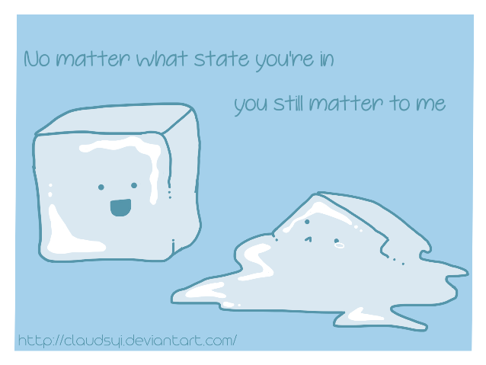
The Heart of the Matter
Design at least one experimental set-up and procedure which can effectively determine whether something is considered matter or not. Be creative and practical!

